Slide 1
Design Presentation: Monitor & Manage
Owner: Sean Norman
CSA25P | 1 of 2
Session Day/Time: | Day 3, Model, Manage & Secure: 13:00 – 13:30 | Presenters/SMEs: | Presenter: John Doe SME(s): John Doe; Jane Doe
Virtual Format and Software: | Presentation: Single Speaker Presenter, ppt slide presentation, live virtual broadcast via Teams, chat enabled and moderated
Cohort / Breakout Mgmt | No cohorts / breakout activities during this session
Objective of Session: | As a result of attending this, attendees will better be able to…
Existing Sources: | <link to any supporting content sources (if any)>
Learner Content: | <Link to draft ppt slide deck and any other materials that the attendees would be seeing or using as part of this session>
Presenter/ SME Guide Content: | <Link to any supporting materials that are just for the presenter and/or supporting SMEs>
Required Homework + name of session for HW review: | No homework or pre-required content needed for this session

Slide 2
Design Presentation: Monitor & Manage
Owner: Sean Norman
CSA25P | 2 of 2
Session Flow and Detailed Agenda |  | Presenter/SME: | Time
Prework | No attendee pre-work needed for this session | N/A | N/A
Session Introduction | Set context for when this process takes place | <presenter> | 3 mins
Body of the session / discussion, activities, Q&A... | Monitor Hub: Pipelines, SQL Pools, Spark apps Azure Advisor recommendations Maintenance windows Automatic statistics management Workload Management | <presenter> | 25 mins
Session Closing / Homework | Go to break Review timing for break, remind audience to stay signed into the meeting, when session will resume, and what they will be doing next. (Data Loading & Data Lake Organization) | <presenter> | 2 mins

Slide 3
Topics Covered
Monitor Hub: Pipelines, SQL Pools, Spark apps Azure Advisor recommendations Maintenance windows Automatic statistics management Workload Management

Slide 4
Monitor & Manage
CSA25P

Slide 5

Agenda sample 1
1 Monitoring
Monitor resources within Synapse Studio and the Azure Portal.
2 Manage
Manage resources for optimal utilization and performance.

Slide 6
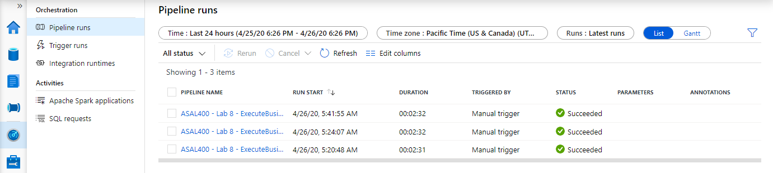
Monitor within Monitor Hub
Overview
Within Synapse Studio you can monitor Pipeline Runs, Trigger Runs, Spark applications and SQL requests.

Slide 7
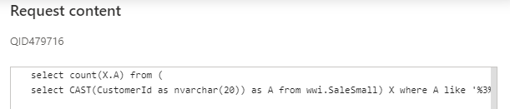
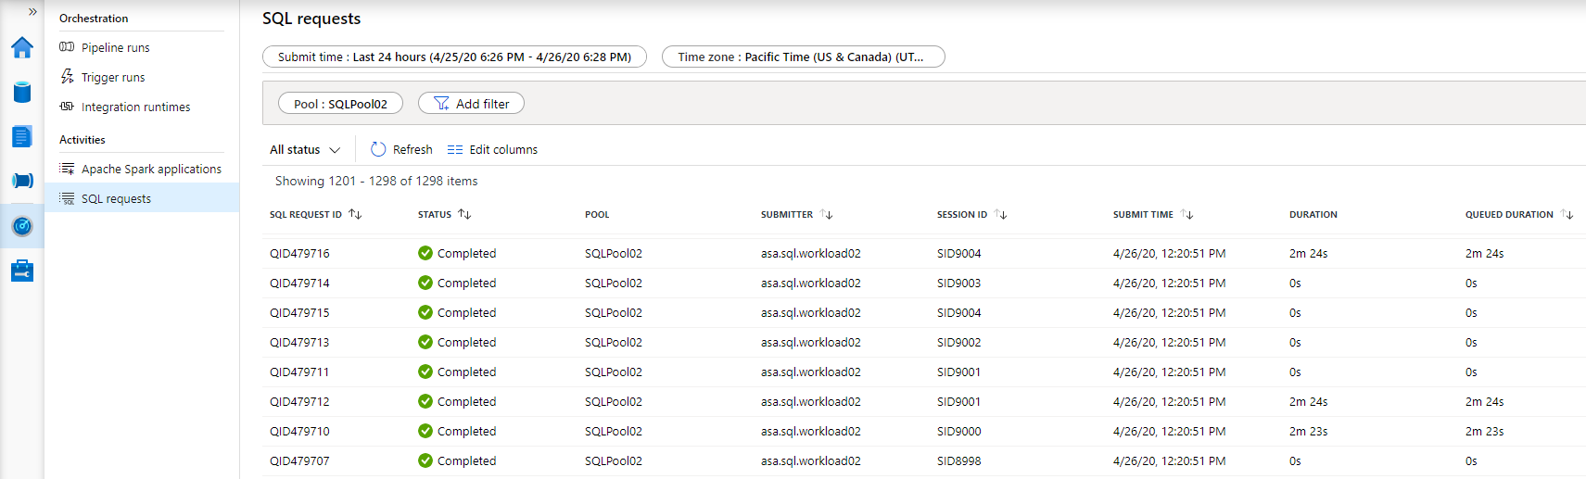
Monitor SQL Requests
Overview
Monitor SQL requests and view the content of the SQL queries.
Benefits
View SQL requests, filter by time, user, workload group, and other properties.

Slide 8
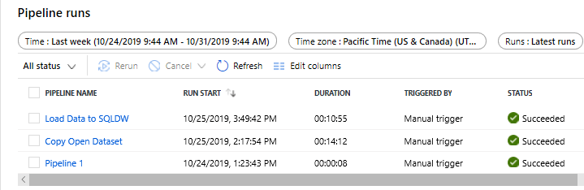
Monitor Orchestration
Overview
Monitor orchestration in the Synapse workspace for the progress and status of pipeline
Benefits
Track all/specific pipelines
Monitor pipeline run and activity run details
Find the root cause of pipeline failure or activity failure

Slide 9
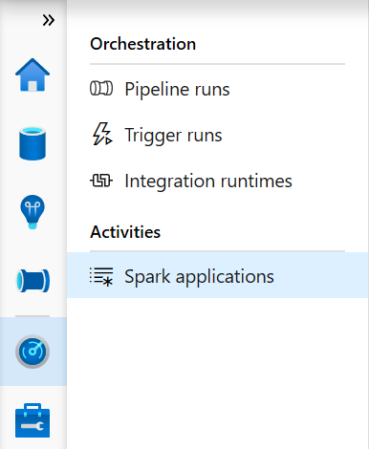
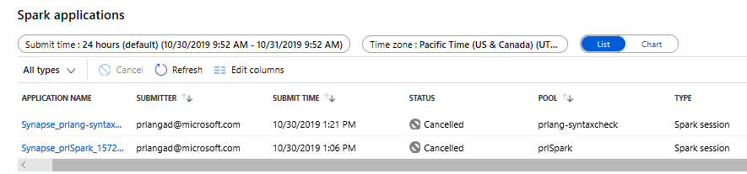
Monitor Spark applications
Overview
Monitor Spark pools, Spark applications for the progress and status of activities
Benefits
Monitor Spark pools for the status as paused, active, resume, scaling and upgrading
Track the usage of resources

Slide 10
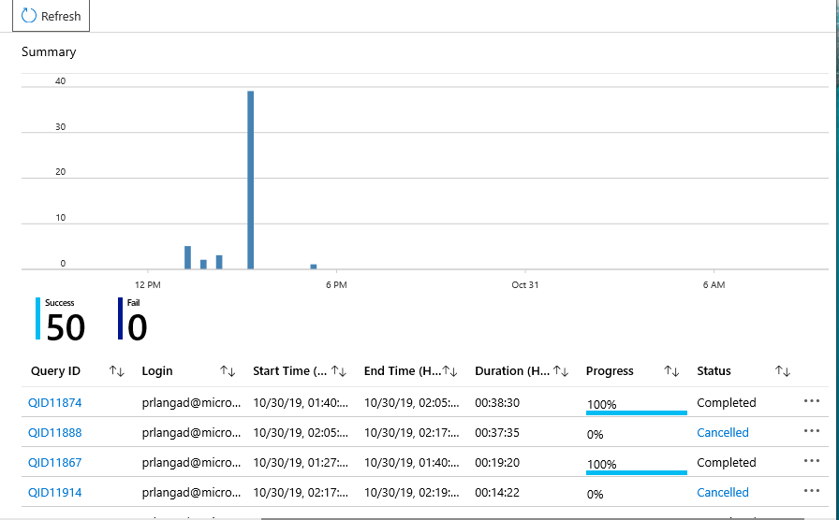
Monitor SQL Pools
Overview
Monitor SQL Pool in Azure Portal for overall usage and query activities.
Benefits
Access SQL Audit Logs for my SQL computes
Monitor status and progress of all/specific activities
Dashboard view to monitor performance
Get to know scale of SQL compute resource

Slide 11
Workload Management
Pillars of Workload Management
Overview
It manages resources, ensures highly efficient resource utilization, and maximizes return on investment (ROI).
Synapse is moving away from Resource Class and Concurrency Slots to Workload Management.
The three pillars of workload management are
Workload Classification – To assign a request to a workload group and setting importance levels.
Workload Importance – To influence the order in which a request gets access to resources.
Workload Isolation – To reserve resources for a workload group.
Classification
Importance
Isolation

Slide 12
Workload classification
Overview
Map queries to allocations of resources via pre-determined rules.
Use with workload importance to effectively share resources across different workload types.
If a query request is not matched to a classifier, it is assigned to the default workload group.
Benefits
Map queries to both Resource Management and Workload Isolation concepts.
Monitoring DMVs
sys.workload_management_workload_classifiers sys.workload_management_workload_classifier_details
Query DMVs to view details about all active workload classifiers.
CREATE WORKLOAD CLASSIFIER classifier_name
WITH
(
WORKLOAD_GROUP = 'name’
, MEMBERNAME = ‘security_account'
[ [ , ] IMPORTANCE = {LOW|BELOW_NORMAL|NORMAL|ABOVE_NORMAL|HIGH} ] )
[ [ , ] WLM_LABEL = 'label' ]
[ [ , ] WLM_CONTEXT = 'name' ]
[ [ , ] START_TIME = 'start_time' ]
[ [ , ] END_TIME = 'end_time' ]
)[ ; ]
WORKLOAD_GROUP: maps to an existing resource class
IMPORTANCE: specifies relative importance of request
MEMBERNAME: database user, role, AAD login or AAD group

Slide 13
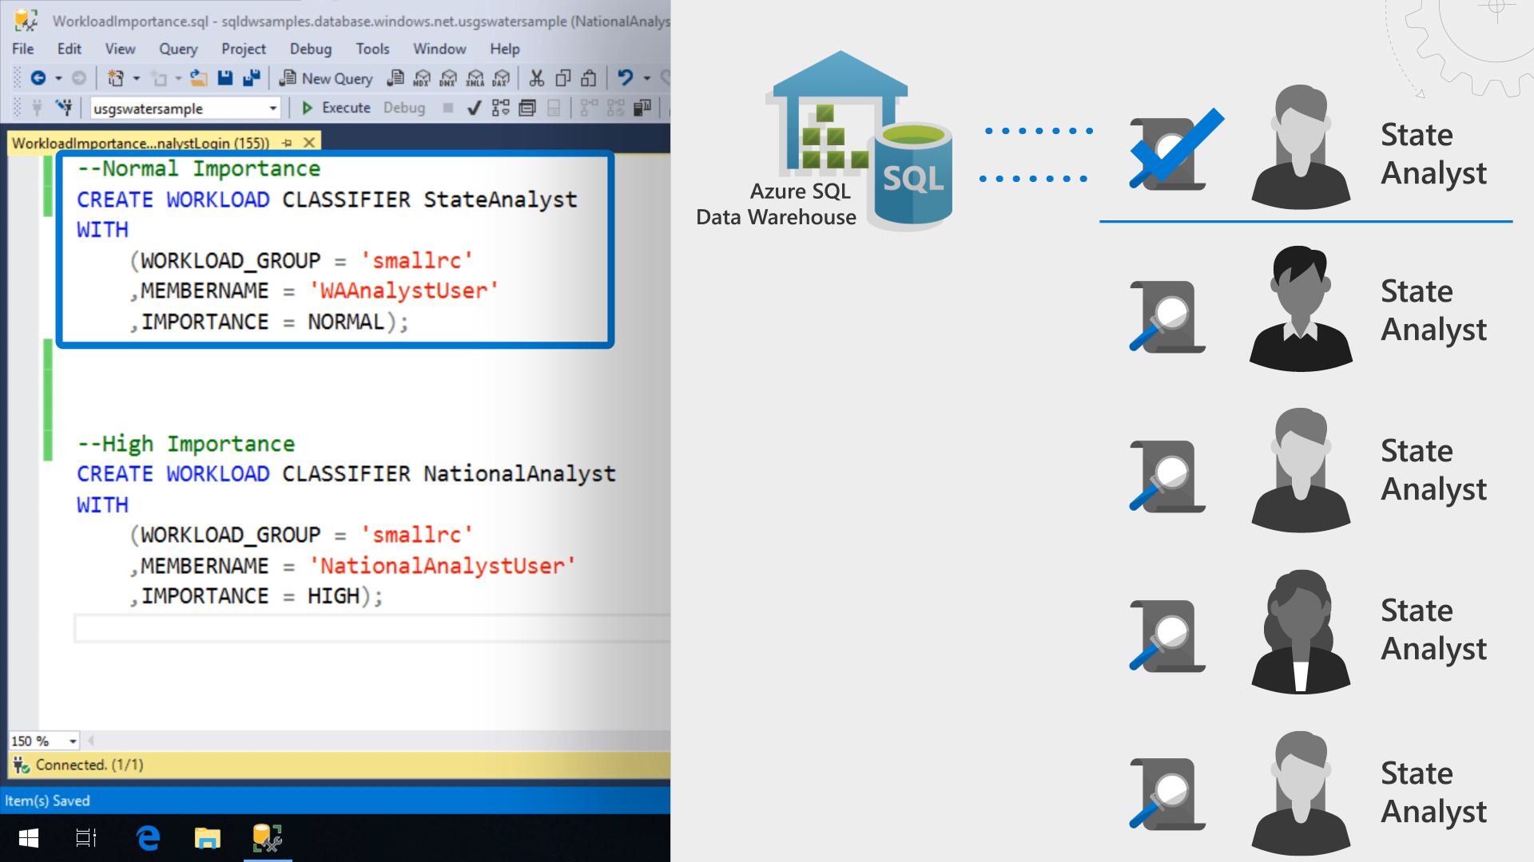

Workload importance
Overview
Queries past the concurrency limit enter a FiFo queue
By default, queries are released from the queue on a first-in, first-out basis as resources become available
Workload importance allows higher priority queries to receive resources immediately regardless of queue
Example Video
State analysts have normal importance.
National analyst is assigned high importance.
State analyst queries execute in order of arrival
When the national analyst’s query arrives, it jumps to the top of the queue
Azure Synapse
Analytics
CREATE WORKLOAD CLASSIFIER National_Analyst
WITH
(
WORKLOAD_GROUP = ‘analyst’
,IMPORTANCE = HIGH
,MEMBERNAME = ‘National_Analyst_Login’)
Notes:
Video example:
National Analyst is given a higher workload importance value

Slide 14
Workload Isolation
Overview
Allocate fixed resources to workload group.
Assign maximum and minimum usage for varying resources under load. These adjustments can be done live without having to SQL Analytics offline.
Benefits
Reserve resources for a group of requests
Limit the amount of resources a group of requests can consume
Shared resources accessed based on importance level
Set Query timeout value. Get DBAs out of the business of killing runaway queries
Monitoring DMVs
sys.workload_management_workload_groups
Query to view configured workload group.
CREATE WORKLOAD GROUP group_name
WITH
(
MIN_PERCENTAGE_RESOURCE = value
, CAP_PERCENTAGE_RESOURCE = value
, REQUEST_MIN_RESOURCE_GRANT_PERCENT = value
[ [ , ] REQUEST_MAX_RESOURCE_GRANT_PERCENT = value ]
[ [ , ] IMPORTANCE = {LOW | BELOW_NORMAL | NORMAL | ABOVE_NORMAL | HIGH} ]
[ [ , ] QUERY_EXECUTION_TIMEOUT_SEC = value ]
)[ ; ]
Notes:
https://docs.microsoft.com/en-us/azure/sql-data-warehouse/sql-data-warehouse-workload-isolation

Slide 15

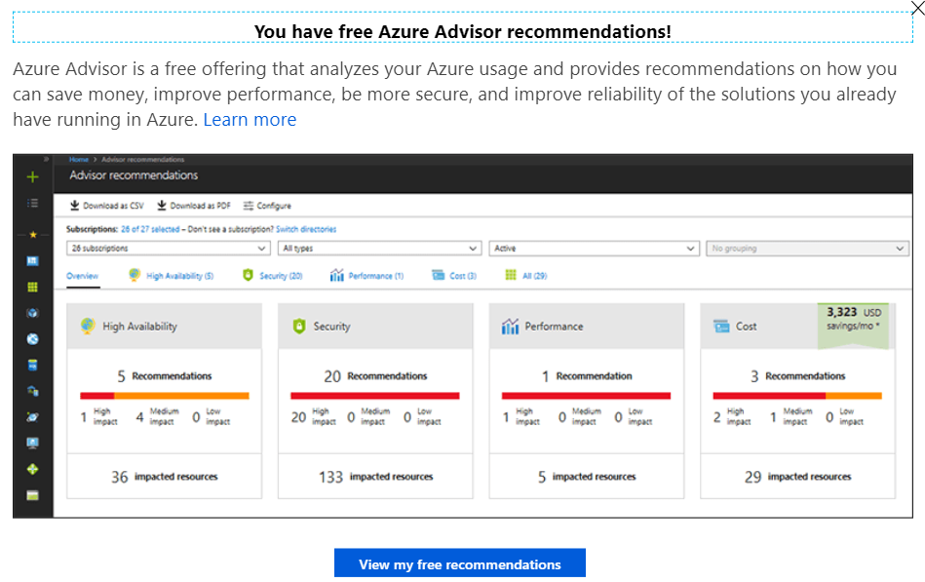
Azure Advisor recommendations
Suboptimal Table Distribution
Reduce data movement by replicating tables
Data Skew
Choose new hash-distribution key
Slowest distribution limits performance
Cache Misses
Provision additional capacity
Tempdb Contention
Scale or update user resource class
Suboptimal Plan Selection
Create or update table statistics

Slide 16
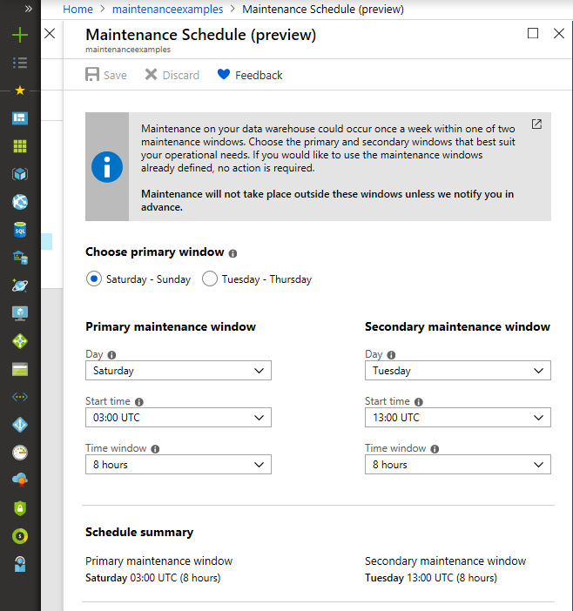
Maintenance windows
Overview
Choose a time window for your upgrades.
Select a primary and secondary window within a seven-day period.
Windows can be from 3 to 8 hours.
24-hour advance notification for maintenance events.
Benefits
Ensure upgrades happen on your schedule.
Predictable planning for long-running jobs.
Stay informed of start and end of maintenance.

Slide 17
Automatic statistics management
-- Turn on/off auto-create statistics settings
ALTER DATABASE {database_name}
SET AUTO_CREATE_STATISTICS { ON | OFF }
-- Turn on/off auto-update statistics settings
ALTER DATABASE {database_name}
SET AUTO_UPDATE_STATISTICS { ON | OFF }
-- Configure synchronous/asynchronous update
ALTER DATABASE {database_name}
SET AUTO_UPDATE_STATISTICS_ASYNC { ON | OFF }
-- Check statistics settings for a database
SELECT is_auto_create_stats_on,
is_auto_update_stats_on,
is_auto_update_stats_async_on
FROM sys.databases
Overview
Statistics are automatically created and maintained for SQL pool. Incoming queries are analyzed, and individual column statistics are generated on the columns that improve cardinality estimates to enhance query performance.
Statistics are automatically updated as data modifications occur in underlying tables. By default, these updates are synchronous but can be configured to be asynchronous.
Statistics are considered out of date when:
There was a data change on an empty table
The number of rows in the table at time of statistics creation was 500 or less, and more than 500 rows have been updated
The number of rows in the table at time of statistics creation was more than 500, and more than 500 + 20% of rows have been updated
Notes:
By default, auto update statistics are configured to be synchronous but can be configured to be asynchronous operations
Statistics are updated opportunistically when queries are run.

Slide 18
Manage Summary
Resource contention can be mitigated by applying Workload Management in Azure Synapse Analytics.
Workload Classification: Assign a request to a workload group and set importance levels.
Workload Importance: Influence the order in which a request gets access to resources.
Workload Isolation: Reserve resources for a workload group.
Use Azure Advisor recommendations to identify suboptimal table distribution, data skew, cache misses, tempdb contention, and suboptimal plan selection.
Avoid disruptive system downtime due to system upgrades by configuring maintenance windows and notifications in Azure Synapse Analytics.
Notes:
Exploratory queries that were not time sensitive can saturate the available resources and delay the execution of higher priority queries supporting critical reports, how can one mitigate this?
Separate marketing workloads from say the finance workloads using workload management.
Configure Workload Management in Azure Synapse Analytics which serves to prevent this situation.
It manages resources, ensures highly efficient resource utilization, and maximizes return on investment (ROI).
The three pillars of Workload Management are:
Workload Classification – To assign a request to a workload group and set importance levels.
Workload Importance – To influence the order in which a request gets access to resources.
Workload Isolation – To reserve resources for a workload group.
If workload management does not suffice, note that online scaling (which allows you to increase the cluster size without incurring downtime) and multi-cluster (which allows you to have several different clusters supporting a single data warehouse) are features that are coming soon.
How can you identify issues such as suboptimal table distribution, data skew, cache misses, tempdb contention and suboptimal plan selection?
Leverage the Azure Advisor recommendations.
There is a balance between the data warehouse software staying up to date and when a customer can afford downtime that might result. How can they establish their preferences, so they are never caught off guard with an upgrade?
Leverage maintenance windows, a feature of Azure Synapse Analytics. Within this they can:
Choose a time window for upgrades.
Select a primary and secondary window within a seven-day period, where windows can be from 3 to 8 hours.
Receive 24-hour advance notification for maintenance events.

Slide 19
Thank You slide
Thank you

